Slide 1
Singular and plural
nouns

Slide 2
Add es to make nouns plural that end with:
s
Buses
x
taxes
ch
benches
sh
dishes

Slide 3
Add ies to make nouns plural that end with a consonant and a y:
lady
ladies
fry
fries

Slide 4
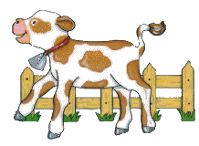
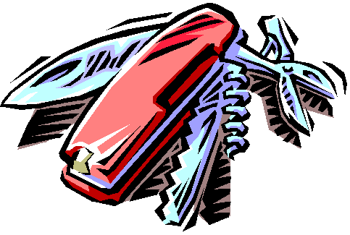
Some nouns that end in f or fe change to ves when made plural:
calf
calves
knife
knives

Slide 5
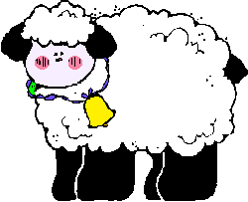
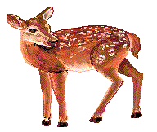
Some nouns do not change at all when made plural:
sheep
sheep
deer
deer

Slide 6
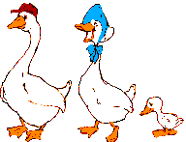
Some nouns become a new word when made plural:
man
men
goose
geese

Slide 7
MAZE
START

Slide 8
Hello dear friends…
I am Dora, today in the morning I missed my friend Mozo.
Would you please help me finding him by answering the following questions?
start playing

Slide 9
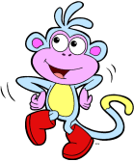
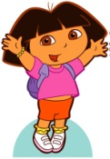
start

Slide 10
continue

Slide 11
continue

Slide 12
continue

Slide 13
continue

Slide 14
continue

Slide 15
continue

Slide 16
continue

Slide 17
continue

Slide 18
continue

Slide 19
continue

Slide 20
continue

Slide 21
continue

Slide 22
continue

Slide 23
continue

Slide 24
continue

Slide 25
The end

Slide 26
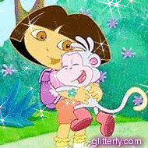
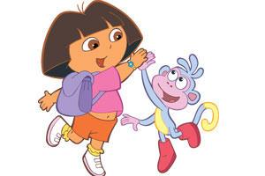
I found my friend…
* Great job*
finish
play again

Slide 27
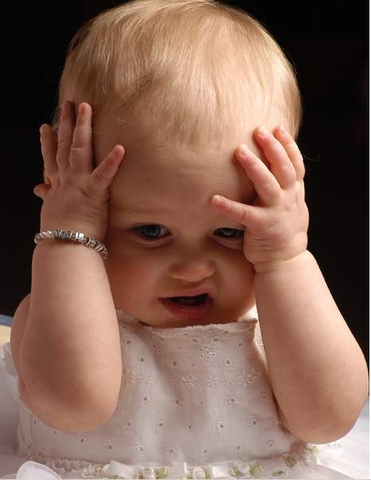
Try again
Click here to return

Slide 28
The plural noun of : sky
skys
skies
skes

Slide 29
The plural noun of : tomato
Tomatoies
Tomatos
Tomatoes

Slide 30
My brother builds ____ house.
a
an

Slide 31
The plural noun of : man
mens
mans
men

Slide 32
We eat five _______ in the morning.
eggies
egges
eggs

Slide 33
Diana has an ______
Jacket
Umbrella

Slide 34
We have an _____ and a ______
Orange / tomato
Tomato/ orange
Orange/ apple

Slide 35
The pupils wait for the ____
busies
buses
buss

Slide 36
The plural noun of mouse:
mouss
mouses
Mice

Slide 37
Put the books at the :
shelfs
shelfes
shelves

Slide 38
The plural noun of potato:
potato
potatoes
potatos

Slide 39
The singular noun of thieves:
thief
thieve
thiev

Slide 40
The singular noun of brushes:
brushes
brushe
brush

Slide 41
The plural of hour:
houres
hours
hories

Slide 42
The plural name of child
child
childs
children

Slide 43
The plural noun of woman
womens
womans
women

